Slide 1
An Intelligent Weapon Detection System for Surveillance Cameras
Graduation Project I (Final Presentation)

Slide 2
Team Members
ID | Name
372029063 | Mohamed Nasser Hashem
372029353 | Mustafa Ahmed Abdulsami
352072163 | Husen Muhammad Kalaepeh
Supervised By
Dr. Emad Nabil

Slide 3
Agenda
Introduction
Importance
Problem statement
Aim & Objectives
Background
Image Classification
Object Localization
Object Detection
Timeline
Methodology
Literature Review
Algorithms
Datasets
Analysis
Requirement
Function & Non-function
Use-Case Descriptions
Actors
Design
Implementation
Tools
Screenshots
Graphical User Interfaces
Unified Modelling Language
Demo Code
Use-Case
Entity Relation
Activity

Slide 4
Introduction

Slide 5
Introduction
Importance & Problem Statement
Security threats have become common and real in this time, humans are no longer able to protect valuables.
On the other hand, the presence of humans has become more intense in public places. With so many criminals impossible to discern them by visual ability,
For this, the developers and the police are working to secure it both technically and realistically. Because security alone is unable to deal with such matters
Social Insurance
Teams
Valuables Insurance

Slide 6
Introduction
Aim
Create a system connected to a camera that can identify the criminal who enters public places, by identifying if he is carrying a gun, trifle, or a knife. and to give a warning to all those present in public place and warn them.
Objectives
Create model(s) for threat/Weapon Detection
Train the model(s) using relevant data sets
Measure the performance of the model(s).
Enhance the system until it reaches an accepted accuracy rate.

Slide 7
Introduction
Methodology
Testing
Maintenance
Design
Implementation
Requirements
Analysis
Problem Identification
Literature Review
Model Implementation
Model Testing
Selection Model & Datasets
GUI
UML
Model Maintenance
Writing Documentation

Slide 8
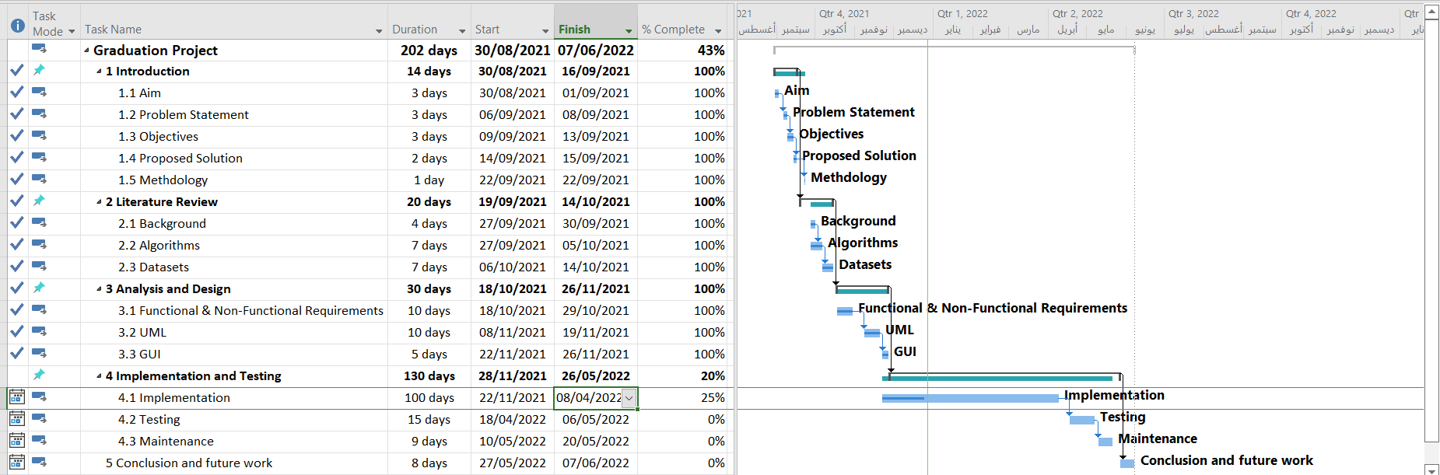
Introduction | Timeline

Slide 9
Background

Slide 10
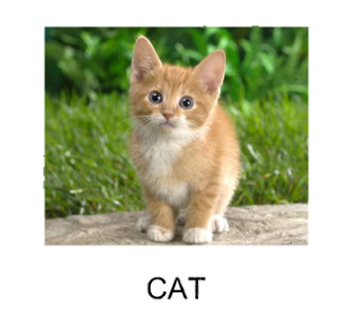
Background
Image Classification
Define:
predicting the class of one item in a picture
Input
a single-object image, such as a photograph, is utilized.
Output
a class label is created (e.g., one or more integers that are mapped to class labels).

Slide 11
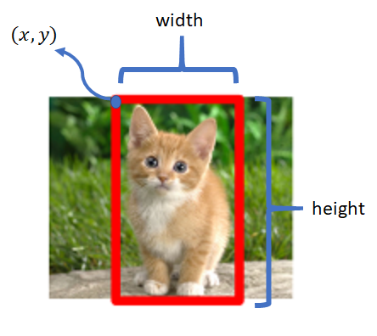
Background
Object Localization
Define:
Determine the presence of items in a photograph and use a bounding box to pinpoint their location.
Input
an image with one or more things, such as a photograph, is utilized.
Output
one or more bounding boxes (e.g., defined by a point, width, and height).

Slide 12
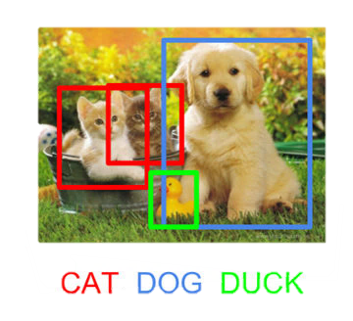
Background
Object Detection
Define:
Using a bounding box, determine the presence of things in an image and the types or classes of the objects discovered
Input
an image with one or more things, such as a photograph, is utilized
Output
One or more bounding boxes (e.g., specified by a point, width, and height)

Slide 13
Background
Object Detection
R-CNN
SSD
YOLO
HOG
Fast R-CNN
Faster R-CNN
R-FCN
YOLO1
YOLO2
YOLO3
YOLO4
YOLO5
Offline
Real-time
Object Detection: Types
Real-time
Task of doing object detection in real-time with fast inference while maintaining a base level of accuracy
Offline
The task of doing the detection of objects, mainly depends on the strength of performance

Slide 14
Literature Review

Slide 15
Literature Review
Algorithms
Compressions

Slide 16
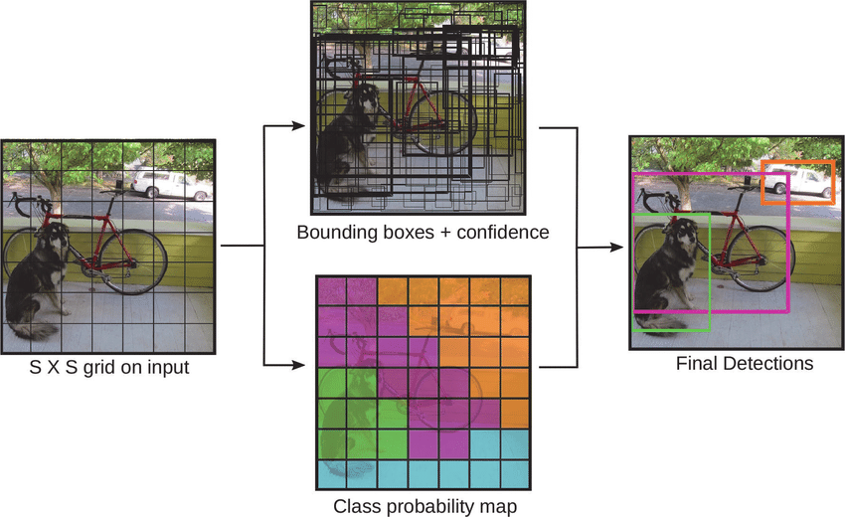
Literature Review
Algorithms
You Just Look Once (YOLO): 2019
A single neural network is used in an object detection method. In contrast to several other object detection algorithms that do a bit-by-bit scan of the picture.

Slide 18
Literature Review
Algorithms
YOLO models comparison

Slide 19

Literature Review
Algorithms
YOLOv5: 2020
The YOLOv5 model is the most current addition to the YOLO family of models. It was created and is maintained using the Darknet framework. YOLOv5 is the first YOLO model to be written in the PyTorch framework, making it significantly lighter and easier to use.

Slide 20
Literature Review
Datasets
Dataset | Gun | Rifle | Knife | People | Total
Crime Detection | 2000 | - | 1050 | 100 | 3150
Weapon detection | 10770 | 187 | 7140 | - | 18097
Weapon Classification | 315 | - | 12900 | - | 13215
Handgun Dataset | 1900 | - | - | - | 1900
Knife Dataset | - | - | 500 | - | 500
Total Datasets |  |  |  |  | 36862

Slide 21
Analysis

Slide 22
Analysis
Function Requirement
Non-Function Requirement
Login
Create account
Identify a person holding a weapon
Create an alarm if a weapon detected
Display camera stream
Logout
The system security
Visibility all 24⁄7
Accuracy in recognizing OD
Speed in recognizing OD
Preserve the privacy of the place

Slide 23
Analysis
Actors
System
Admin
Users

Slide 24
Analysis
Use-Case Description | Determine Object’s Type
Analysing the video stream to decide the type of the object
Job name | Determine Object’s Type
Related Requirements | System
Initiating Actor | System
Actor’s Goal | To analyze and classify the objects
Participating Actors | None
Preconditions | Use model
Postconditions | Object detection
Flow of Events for Main Success Scenario | System use the model Use camera to view Analyze to determine object
Flow of Events for Alternate Scenario | None

Slide 25
Analysis
Use-Case Description | Object Detection
Analysing the video stream to detect each object
Job name | Object Detection
Related Requirements | System
Initiating Actor | System
Actor’s Goal | To detect objects
Participating Actors | None
Preconditions | None
Postconditions | Detect object (weapon)
Flow of Events for Main Success Scenario | System use the model Use the camera’s | Determine objects Detect the objects
Flow of Events for Alternate Scenario | None

Slide 26
Design

Slide 27
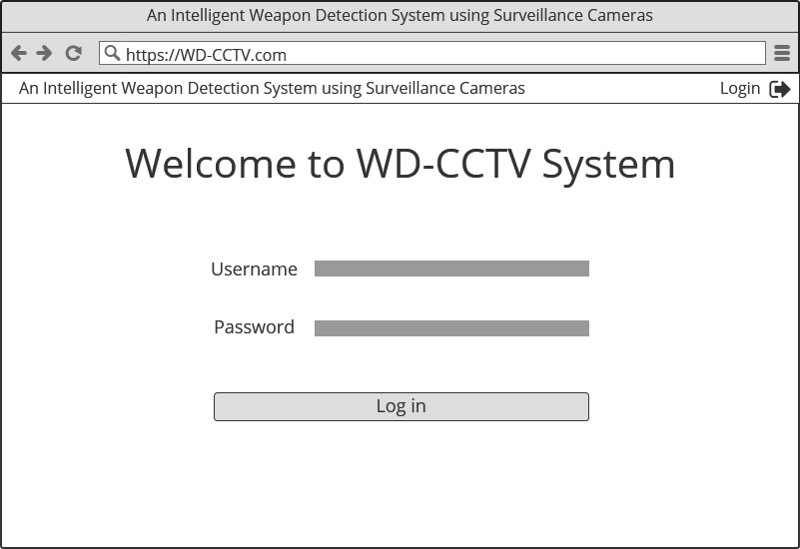
Design
GUI | Login

Slide 28
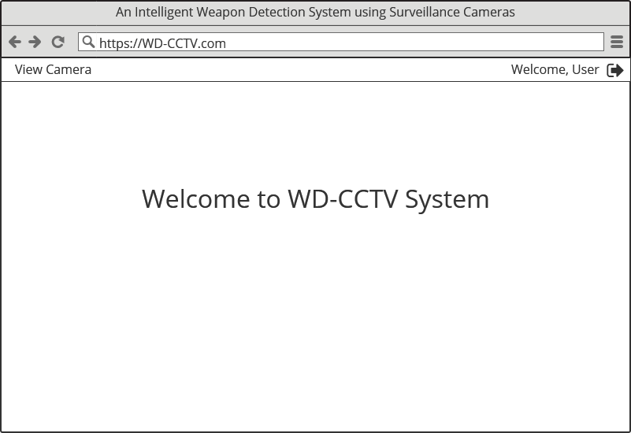
Design
GUI | Main page (User)

Slide 29
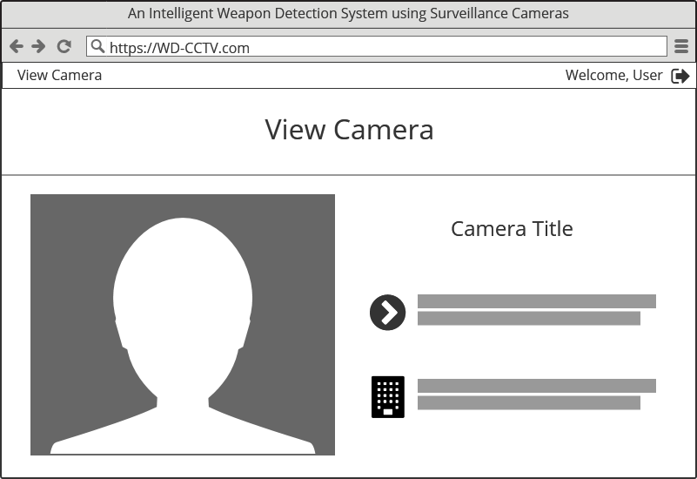
Design
GUI | View Camera (User)

Slide 30
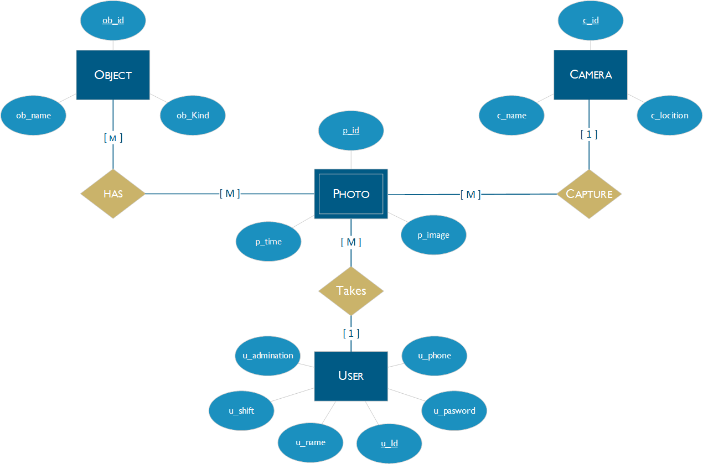
Design
UML | Entity Relationship (ER) | Chen

Slide 31
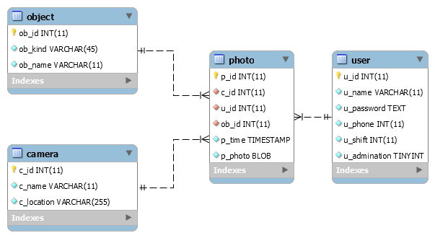
Design
UML | Entity Relationship (ER) | Schema

Slide 32
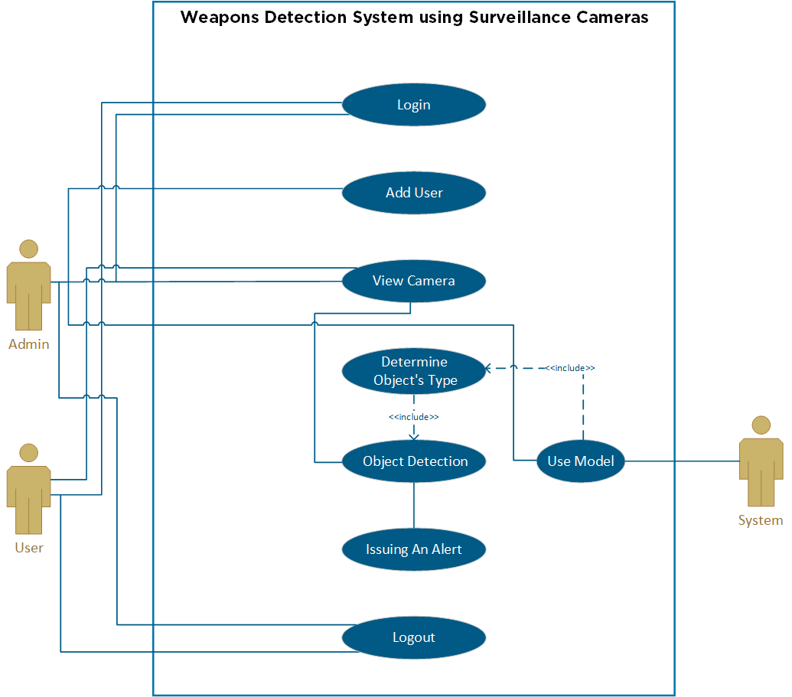
Design
UML | Use-Case

Slide 33
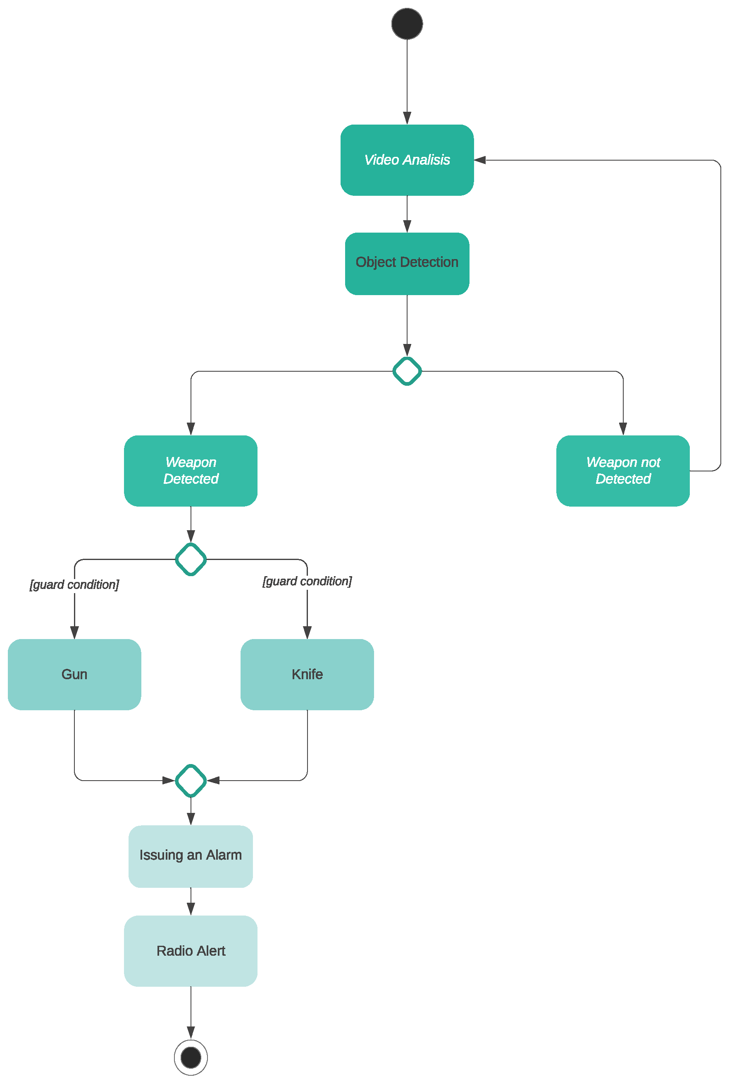
Design
UML | Activity

Slide 34
Implementation

Slide 35




Implementation
Tools
Prog. Language
Code Editor
Visual Studio Code
Code Hosting
Microsoft GitHub
Python
MySQL
Database

Slide 36
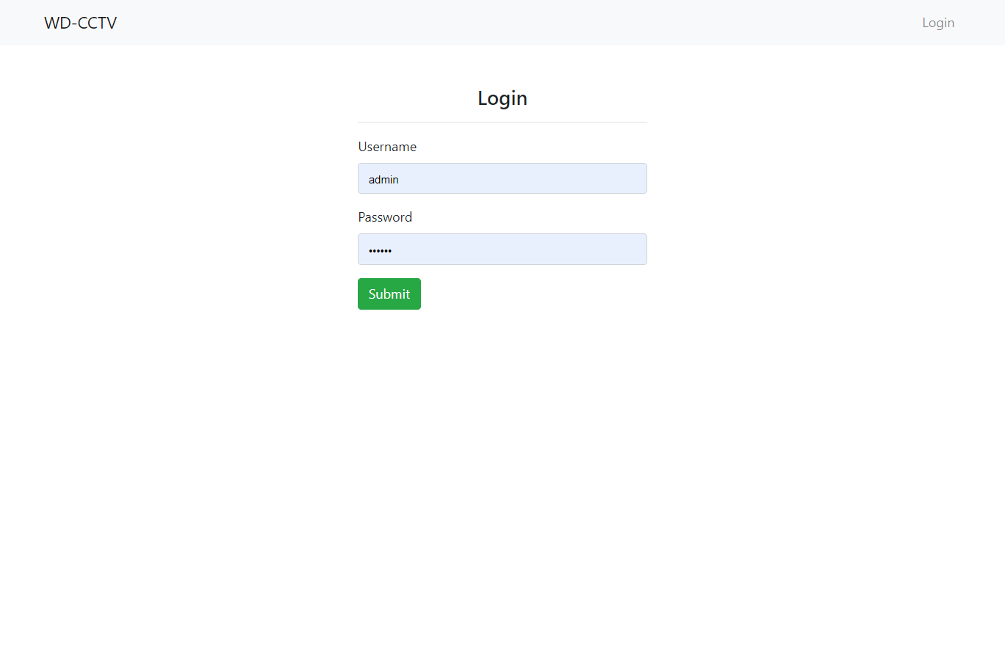
Implementation
Screenshots | Login

Slide 37
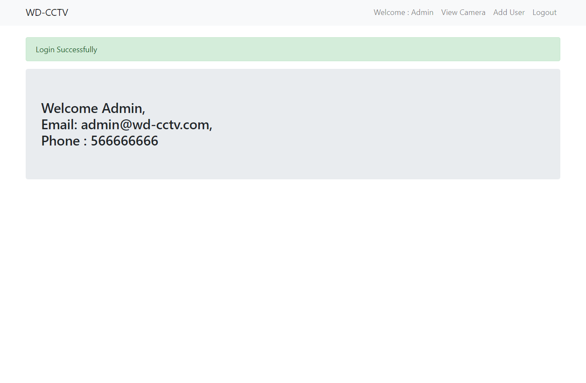
Implementation
Screenshots
Main page (Admin)

Slide 38
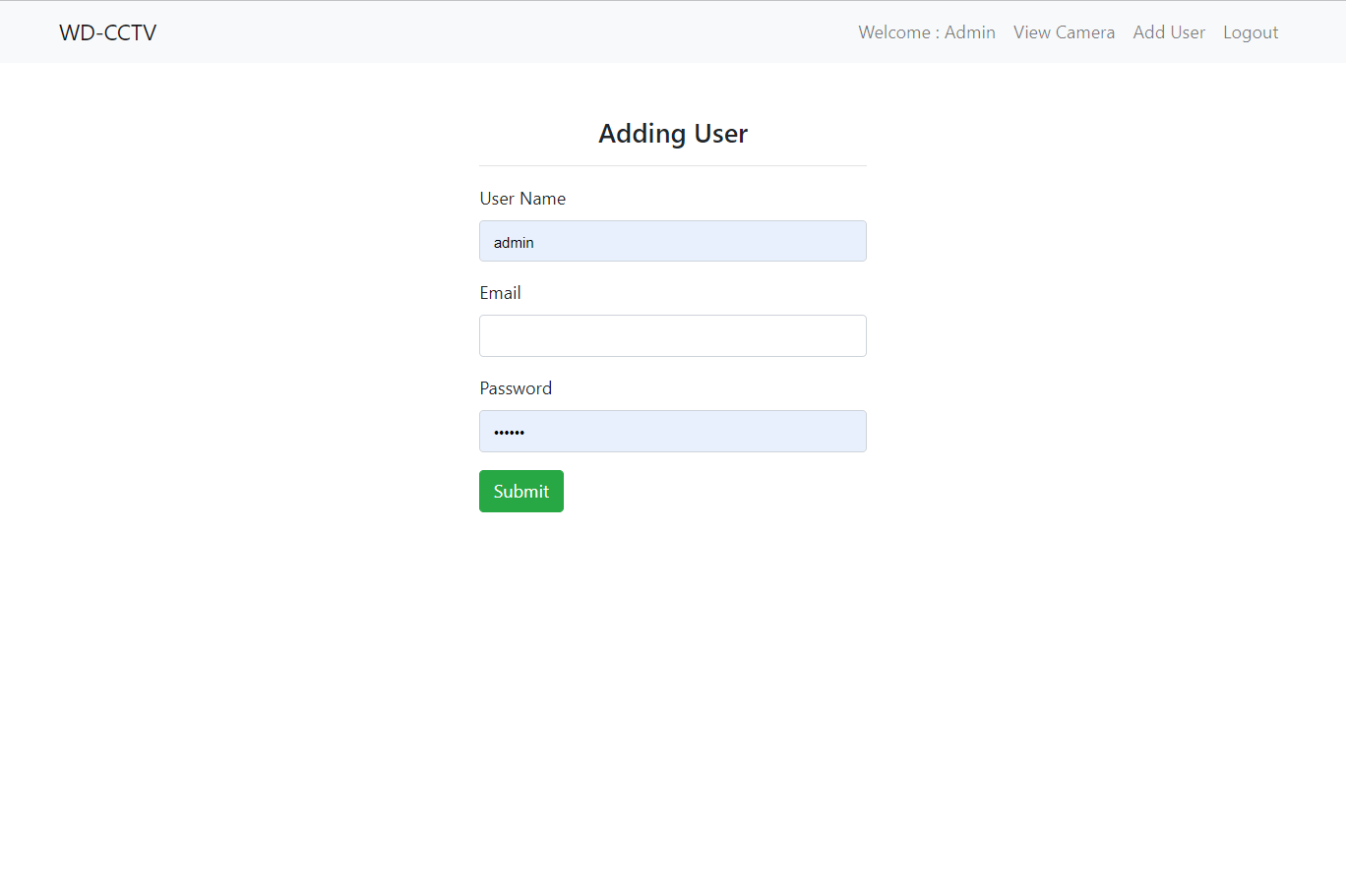
Implementation
Screenshots
Adding User (Admin)

Slide 39
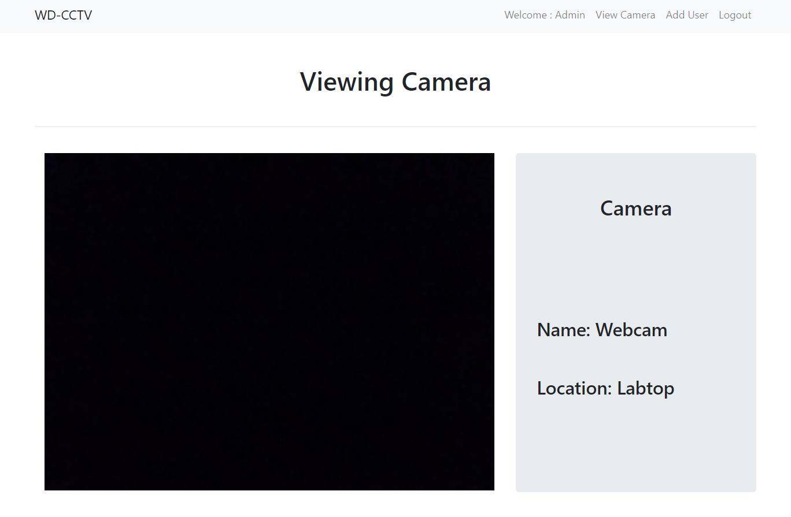
Implementation
Screenshots
Adding User (Admin)

Slide 40
Implementation
Demo

Slide 41

Thanks! For Listening

